Slide 1

Free Meals (Team 7)
Ana Filipa Ferreira
Beatriz Ribeiro
Pedro Serrano
Rui Azevedo

Slide 2

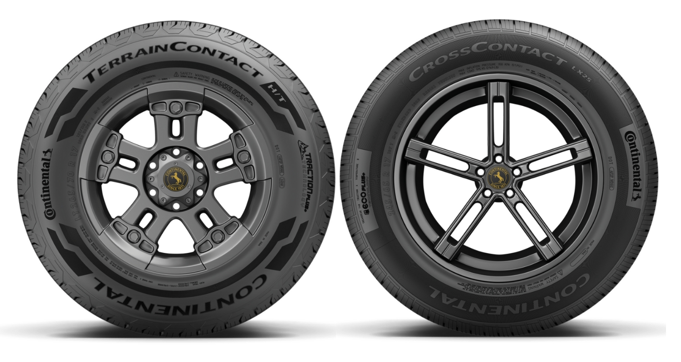
The problem

Slide 3

The solution
Pretty sure the serial nr is 139981237

Slide 4
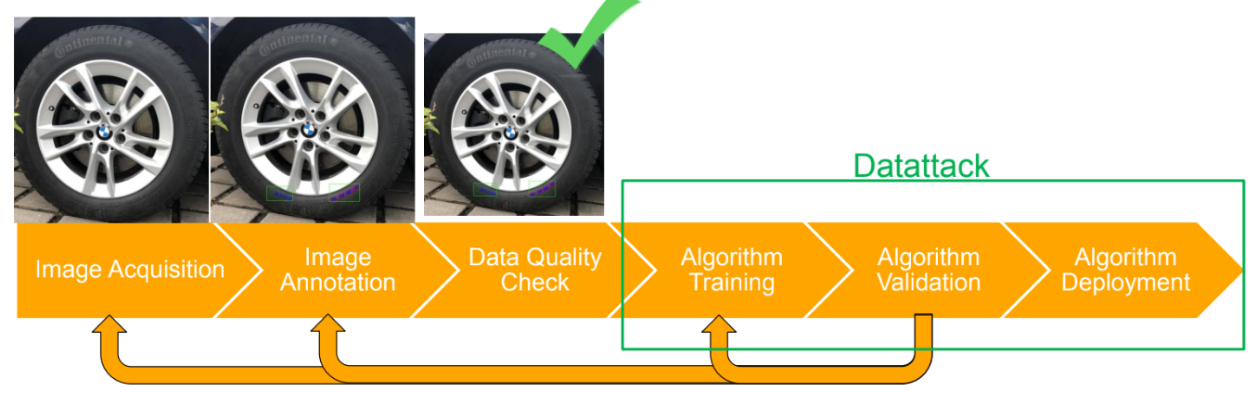
Solution Development

Slide 5
Dataset (COCO format)
annotation
image
id
image_id
category_id
area
bbox
iscrowd
attributes
category
id
file_name
width
height
id
name
supercategory

Slide 6
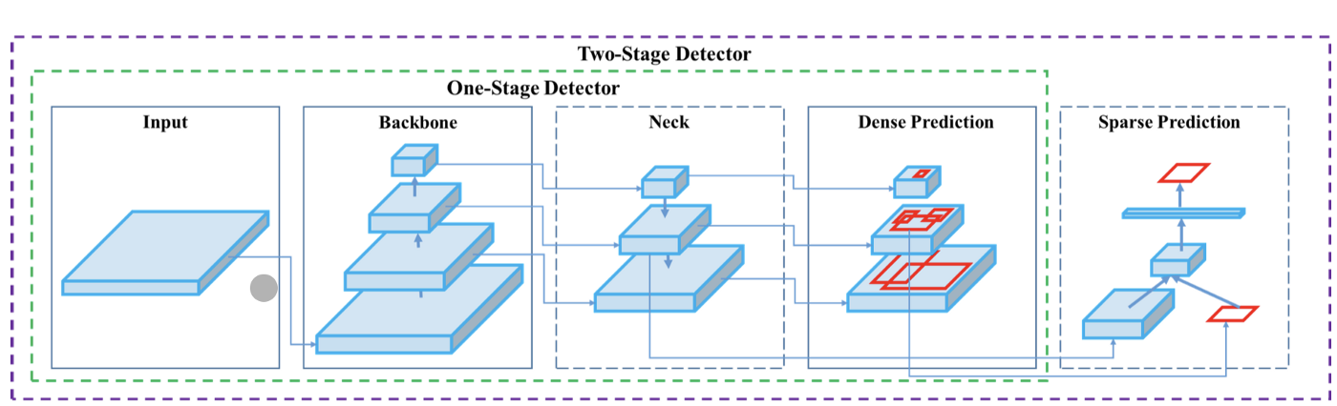
Methodology
{Images, Patches, …}
{VGG16, ResNet-50, Darknet53, …}
{FPN, PANet, Bi-FPN, …}
{RPN, YOLO, SSD, RetinaNet, …}
{Faster R-CNN, R-FCN, …}
Notes:
The architecture consists of various parts, broadly they are - The input which comes first and it is basically what we've as our set of training images which will be fed to the network - they are processed in batches in parallel by the GPU. Next are the Backbone and the Neck which do the feature extraction and aggregation. The Detection Neck and Detection Head together can be called as the Object Detector.

Slide 7
Split train and validation
Estimate the performance of algorithms to predict the number in COCO image
TRAIN 80 %
VALIDATION 20 %
Evaluation Metrics:
Validation Loss
Levenshtein Distance (multi-shot detector)
mAP (YOLO)
Evaluation Process:
Split the original data
Obtain a validation set
Apply this in train set

Slide 8
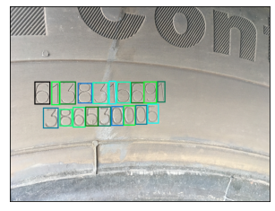
Faster R-CNN model with a ResNet-50-FPN backbone
Learning Rate: 0.0001
Batch Size: 1
Transfer Learning: ON
Average Levenshtein distance: 0.22

Slide 9
Faster R-CNN model with a ResNet-50-FPN backbone
Model Prediction:
6138315691
38653005
Us after a long day of coding: zzzzzzzzzzzzz

Slide 10

YOLO v4
Learning rate = 0.001
1200 iterations to train a Custom YOLOv4 Detector
-> mean_average_precision (mAP@0.5) = 0.98
Notes:
Algorithm that uses convolutional neural networks for object detection

Slide 11
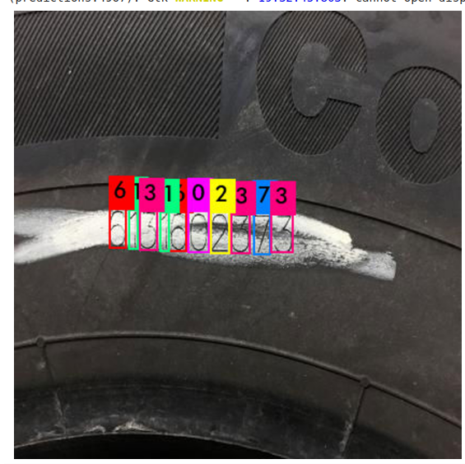
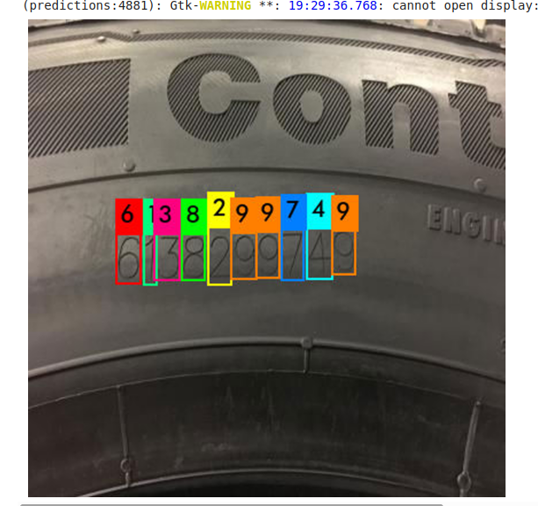
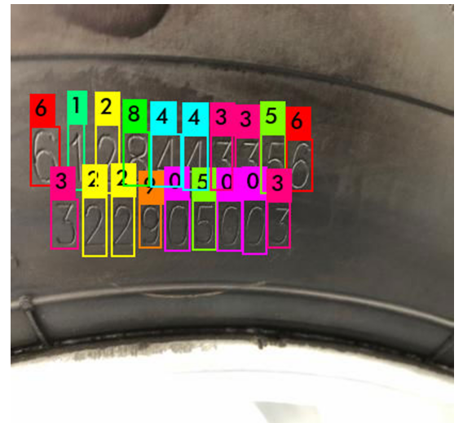
YOLO v4

Slide 12
Output
Bounding boxes to mark an object [xmin, ymin, xmax, ymax]
number = category_id - 1

Slide 13
Conversion to serial numbers
Take advantage of the preprocessing of the images on the test set:
Serial numbers are very close to horizontal!
Remove false detections (low confidence scores)
Sort labels and bounding boxes on y-axis
Split into two group based two groups based on avg. y
If there is only on serial, second group is empty
Sort labels on x-axis
Concatenate to string

Slide 14
Evaluation
Levenshtein distance
Is a measure of similarity between two strings. It is defined as the minimum number of changes required to convert string a into string b (this is done by inserting, deleting or replacing a character in string a)
Mode is optimized for this, per the requirements
However, in the real world, missing one digit or five in a serial number produces the same outcome: a wrong result
For a real world deployment, we should focus on full number accuracy or recall

Slide 15
Conclusions
We managed to obtain low Levenshtein distances (~0.22) in the training set
Despite this good score, failure to perform validation may cause the model to be overfit
For Yolo v4 we were able to test the validation set with good mAP results but we weren’t able to measure the Levenshtein distance
If we had more time, we would:
Solve the problem we encountered in validation,
Implement a more robust validation mechanism (e.g. CV)
Implement a better scoring method that would work for a deployable model

Slide 16
Any questions?
Notes:
O que já foi feito?

